Slide 1

`
COVID-19 Future Forecasting Using Supervised
Machine Learning Models
F. Rustam, A. A. Reshi, A. Mehmood, S. Ullah, B. W. On, W. Aslam and G. S. Choi,
“COVID-19 future forecasting using supervised machine learning models,” IEEE Access, vol. 8, pp.101489-101499, May 2020.
Presenter: Ashish Kumar
Advisor: Prof. Yo-Ping Huang

Slide 2
CONTENTS
Proposed work
Introduction
Materials and methods
Methodology
Results and discussion
Conclusion

Slide 3
PROPOSED WORK
Authors aim to provide an early forecast model for the spread of novel coronavirus.

Slide 4
INTRODUCTION
ML has proved itself prominent over last decade by solving problems in health care, autonomous vehicles (AV), business applications, natural language processing(NLP), intelligent robots, gaming, climate modelling, voice and image processing.
ML algorithms are based on trial and error method opposite from conventional algorithms which following programming based on decision statements like if-else.
Forecasting is one of most prominent area of ML. Applications – weather forecasting, disease forecasting, stock market forecasting and disease prognosis.

Slide 5
Authors did forecasting based on three important variables of the disease for the coming 10 days.
Number of new confirmed cases.
Number of death cases.
Number of recoveries.
Forecasting was considered as regression problem in their study.

Slide 6
MATERIALS AND METHODS
DATASET
Dataset used in the study has been obtained from the Center for Systems Science and Engineering, Johns Hopkins University.
Authors used 85% of data for training and 15% of data for testing.
File name: csse_covid_19_time_series contains daily time series summery tables.
Data is updated after every 1 or 2 days.

Slide 7
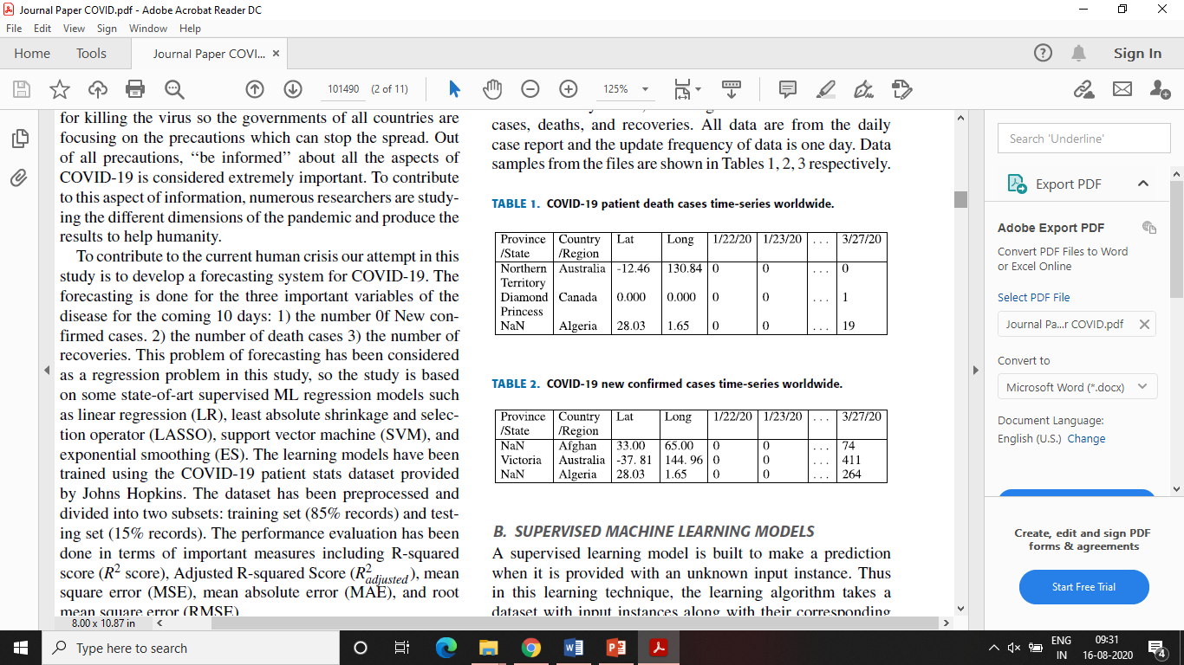
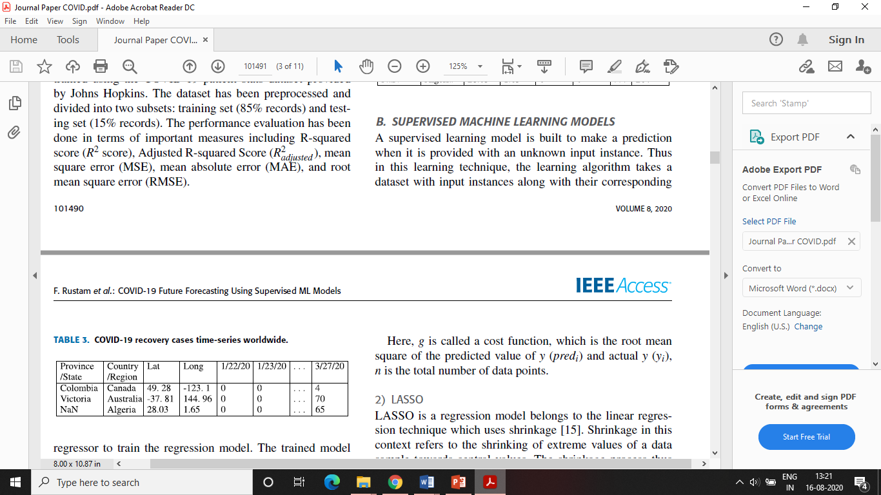

Slide 8
SUPERVISED MACHINE LEARNING MODELS
Supervised learning model is built to make a prediction when it is provided with an unknown input instance.
The learning algorithm takes a dataset with input instances along with their corresponding regressor to train the regression model.
Trained model then generates a prediction for the given unforeseen input data or test dataset.

Slide 9
Authors used four regression models those are:
Linear Regression
LASSO Regression
Support Vector Machine
Exponential Smoothing

Slide 10
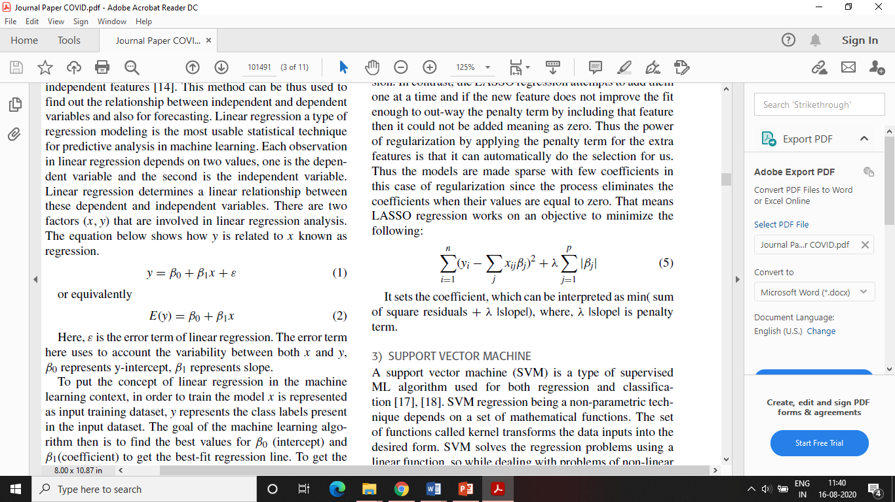
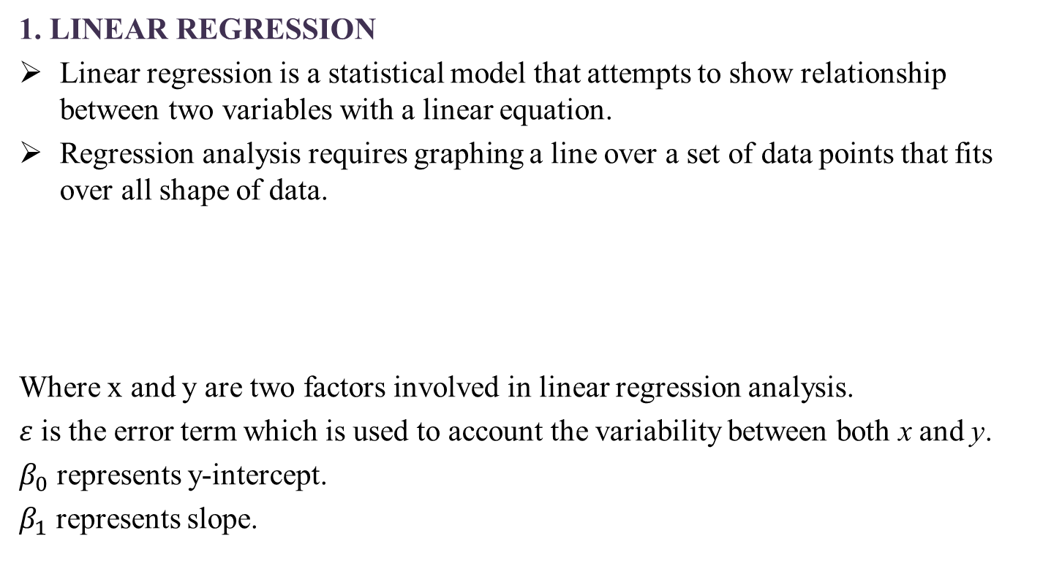
1. LINEAR REGRESSION
Linear regression is a statistical model that attempts to show relationship between two variables with a linear equation.
Regression analysis requires graphing a line over a set of data points that fits over all shape of data.
Where x and y are two factors involved in linear regression analysis.
$ε$ is the error term which is used to account the variability between both x and y.
$β_{0}$ represents y-intercept.
$β_{1}$ represents slope.

Slide 11
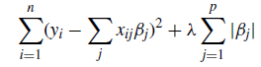
2. LASSO (Least absolute shrinkage and selection operator)
LASSO is a regression model belongs to the linear regression technique which uses shrinkage.
Shrinkage refers to the shrinking of extreme values of a data sample towards central values making LASSO more stable and also reduces error.
It uses a regularization method for automatically penalizing the extra features.
Goal of the algorithm is to minimize:
Sum of squares
Penalty
Notes:
The features that cannot help the regression results enough can be set to a very small value potentially zero.
An ordinary multivariate regression uses all the features available to it and will assign each one a coefficient of regression.
In contrast, the LASSO regression attempts to add them one at a time and if the new feature does not improve the fit enough to out-way the penalty term by including that feature then it could not be added meaning as zero.

Slide 12
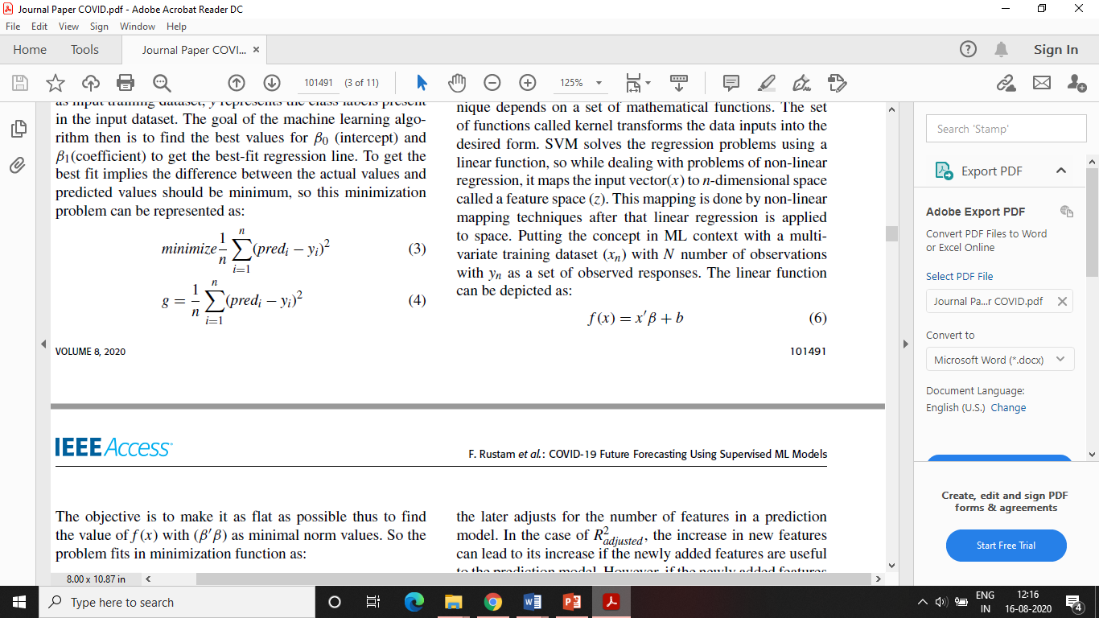
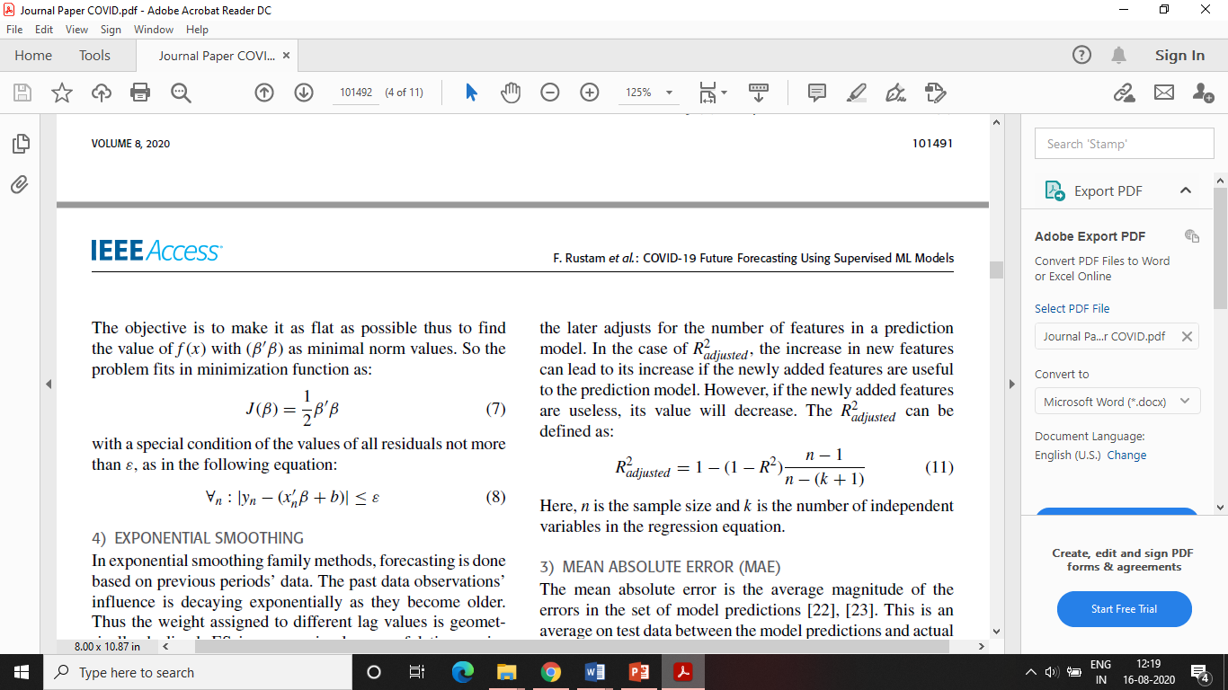
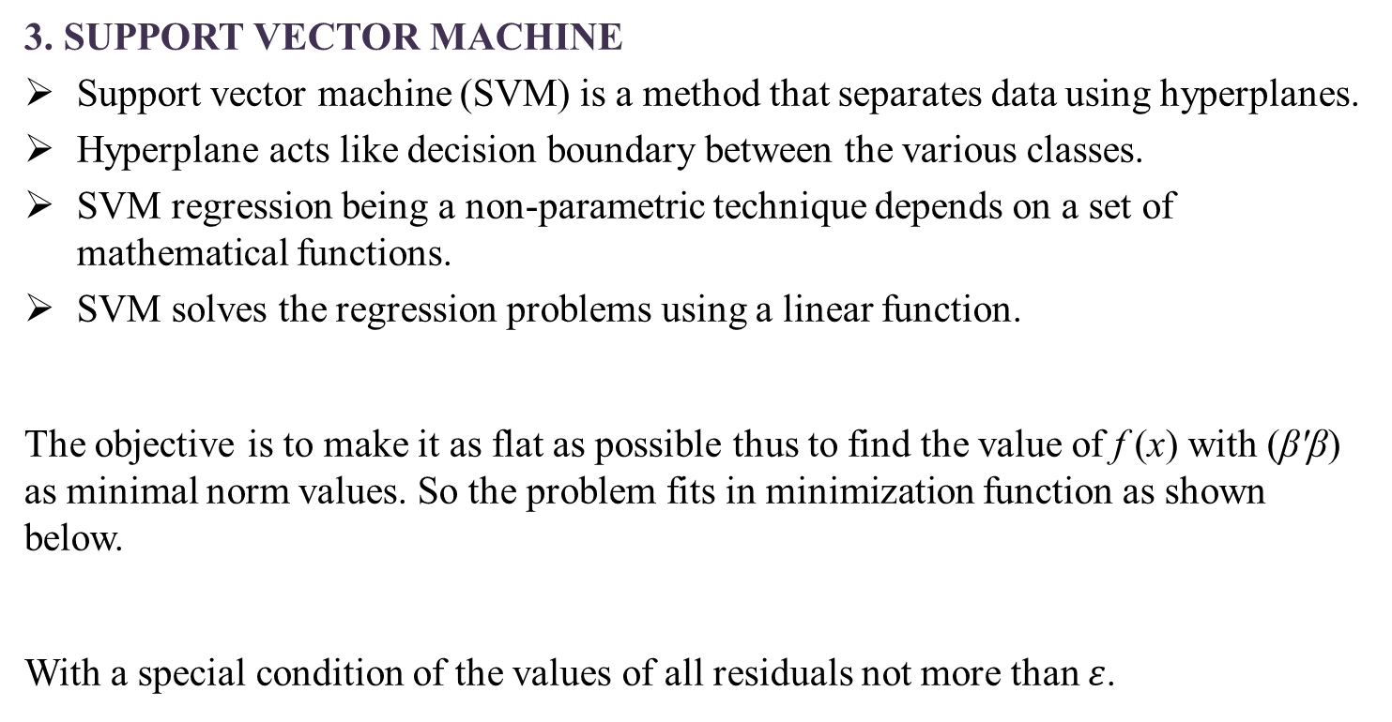
3. SUPPORT VECTOR MACHINE
Support vector machine (SVM) is a method that separates data using hyperplanes.
Hyperplane acts like decision boundary between the various classes.
SVM regression being a non-parametric technique depends on a set of mathematical functions.
SVM solves the regression problems using a linear function.
The objective is to make it as flat as possible thus to find the value of f (x) with (β'β) as minimal norm values. So the problem fits in minimization function as shown below.
With a special condition of the values of all residuals not more than $ε$.
Notes:
Wx+b is prediction for that sample ;1/2||w^2|| is minimize; y=wx+b<=episilon ; y-wx-b<=episilon
A support vector machine (SVM) is a type of supervised ML algorithm used for both regression and classification.
The set of functions called kernel transforms the data inputs into the desired form.
Kernel trick basically means to transform your data into another dimension so that you can easily draw a hyperplane between different classes of data.
so while dealing with problems of non-linear regression, it maps the input vector ($x$) to n-dimensional space called a feature space ($z$). This mapping is done by non-linear mapping techniques after that linear regression is applied to space. Putting the concept in ML context with a multivariate training dataset ($x_{n}$) with N number of observations with y_{n} as a set of observed responses. The linear function can be depicted as shown in Eq. 2.
$f(x)= x′β+ b$(2)
The objective is to make it as flat as possible thus to find the value of f (x) with (β'β) as minimal norm values. So the problem fits in minimization function as shown in Eq. 3.
$J(β)y= \frac{1}{2}β′β$(3)
With a special condition of the values of all residuals not more than $ε$, which is described in Eq. 4.
$∀_{n}:{|y}_{n}−{(x}_{n}^{′}β+b)|≤ε$(4)

Slide 13
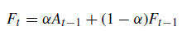
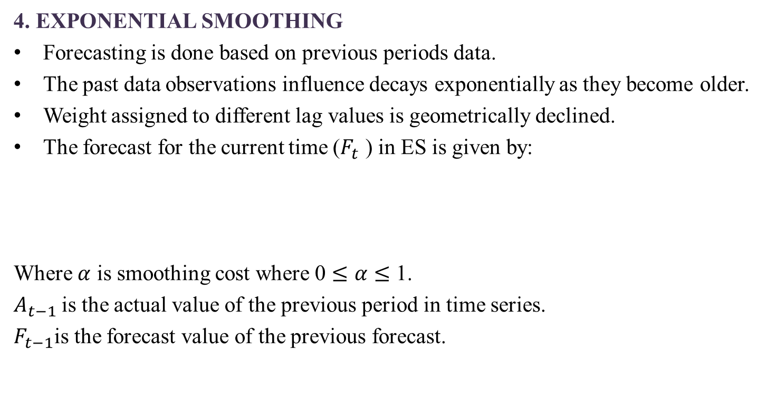
4. EXPONENTIAL SMOOTHING
Forecasting is done based on previous periods data.
The past data observations influence decays exponentially as they become older.
Weight assigned to different lag values is geometrically declined.
The forecast for the current time ($F_{t}$ ) in ES is given by:
Where $α$ is smoothing cost where 0 $≤α≤$ 1.
$A_{t−1}$is the actual value of the previous period in time series.
$F_{t−1}$is the forecast value of the previous forecast.

Slide 14
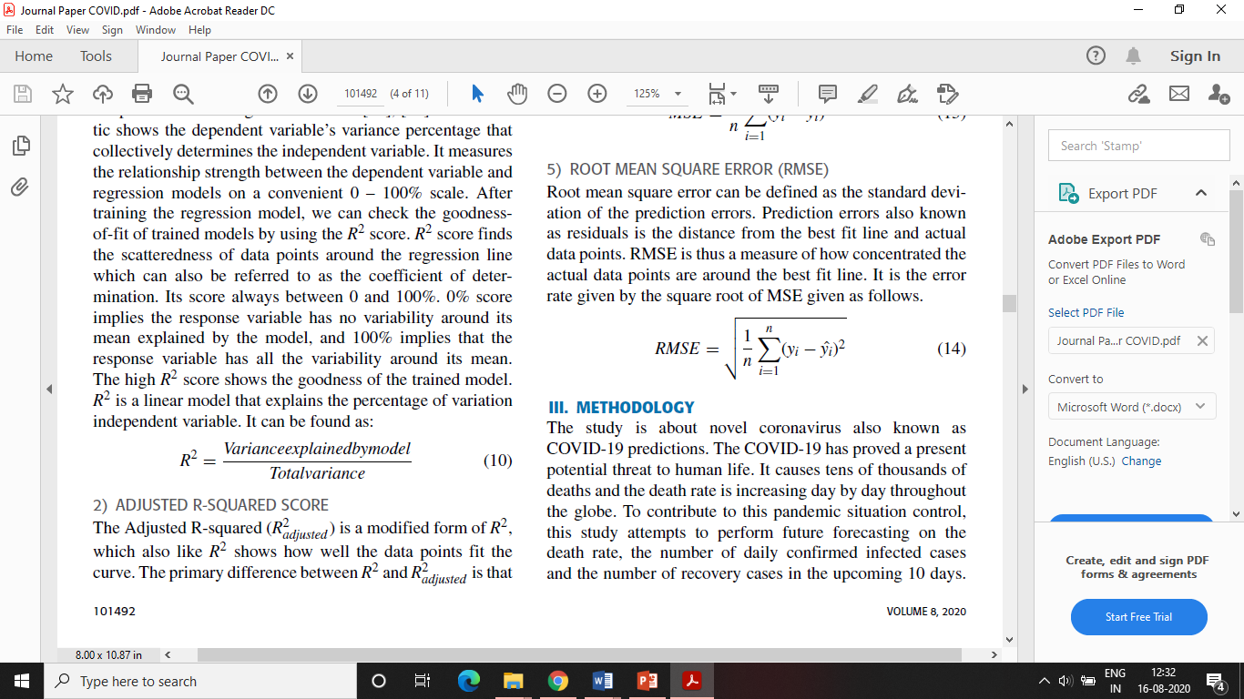
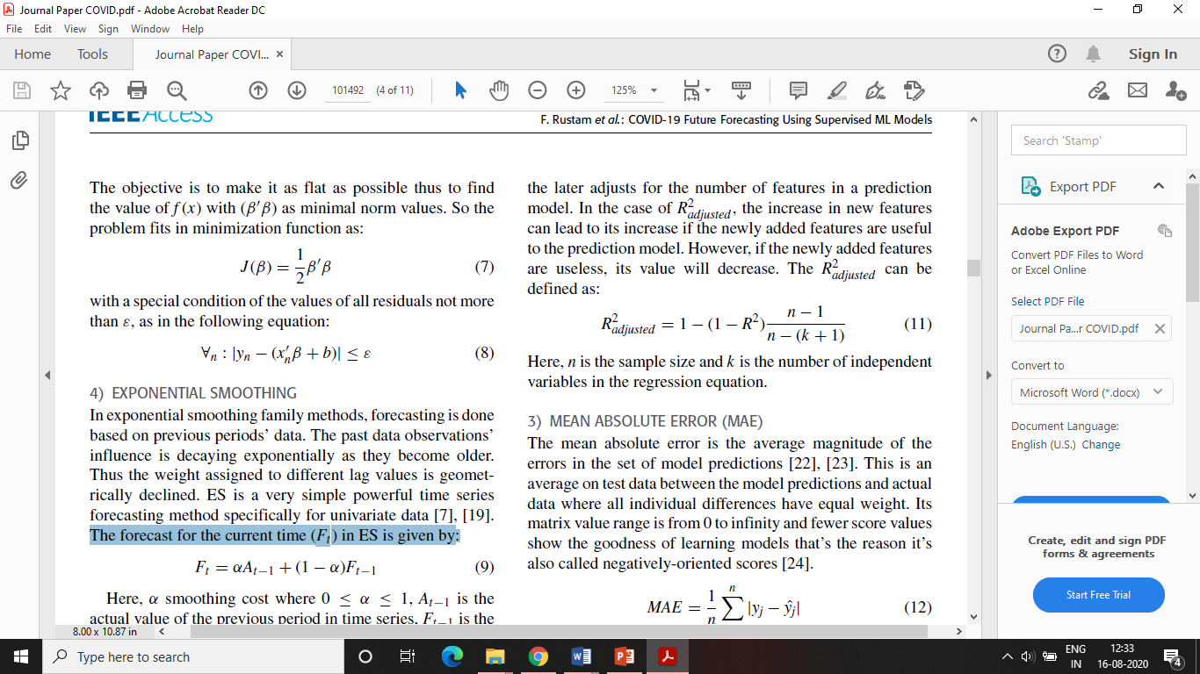
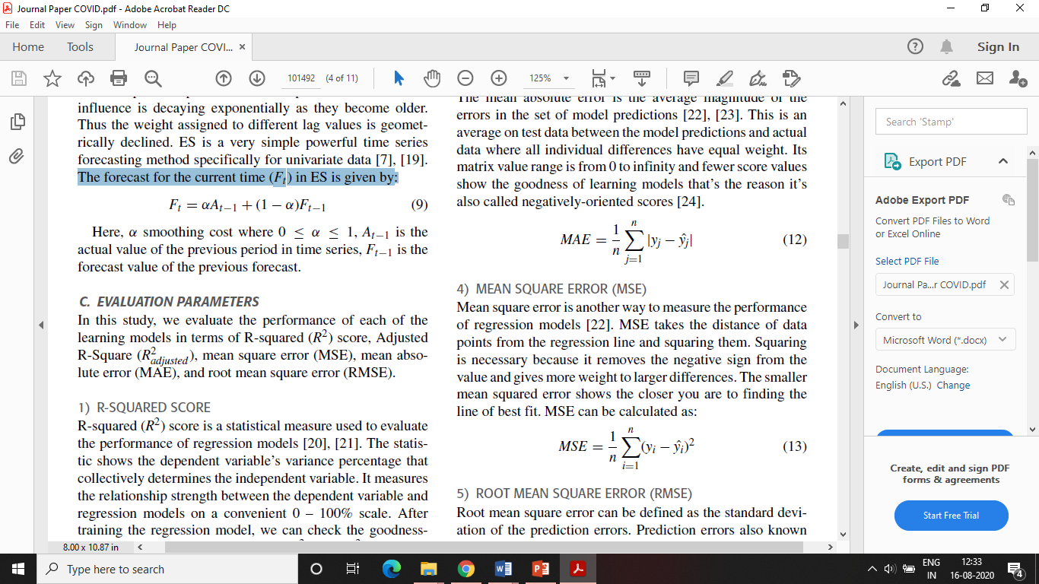
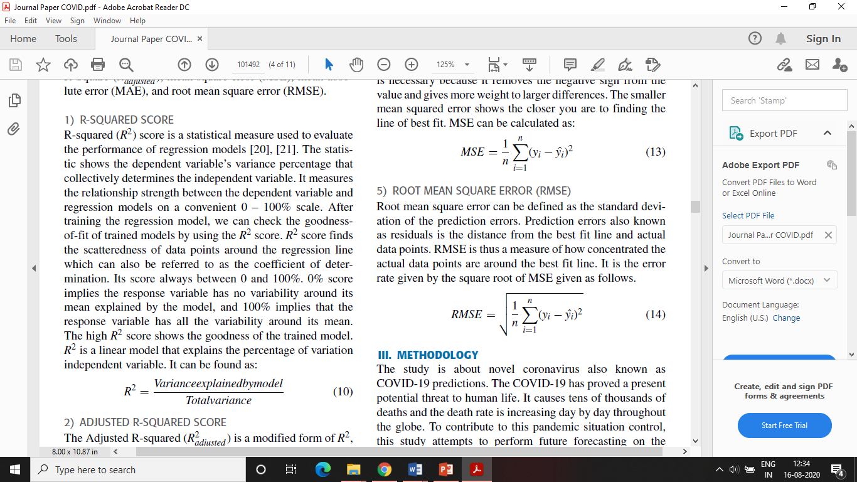
EVALUATION PARAMETERS
sample size
number of independent variables in regression equation
average magnitude of the
errors in set of model predictions
distance of data
points from the regression line and squaring them
standard deviation
of the prediction errors

Slide 15
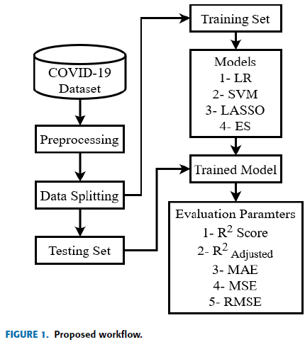
METHODOLOGY

Slide 16
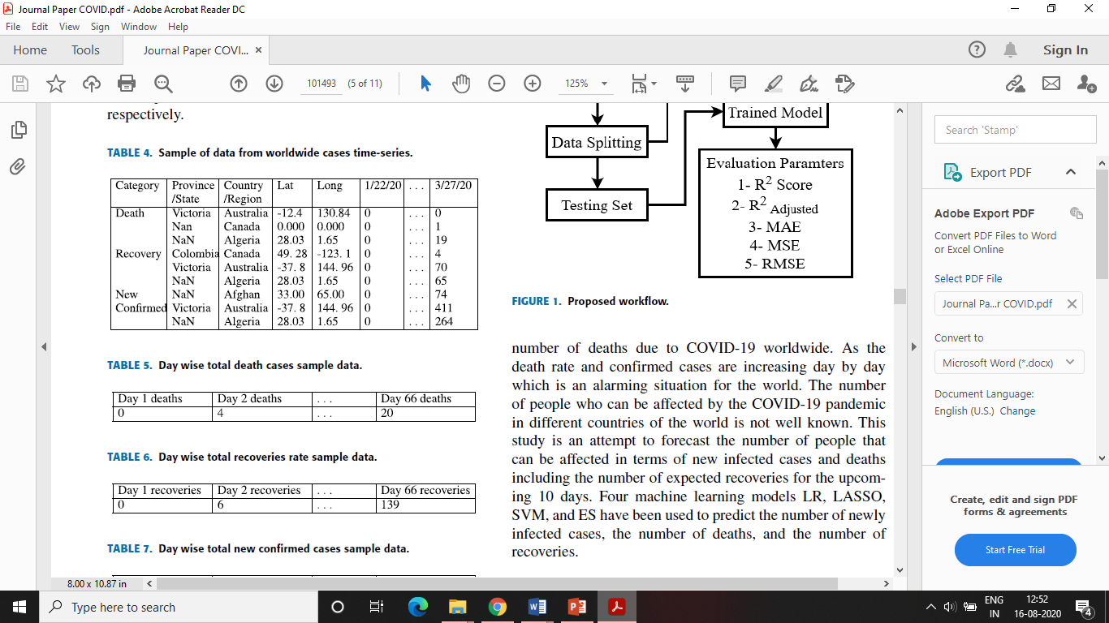
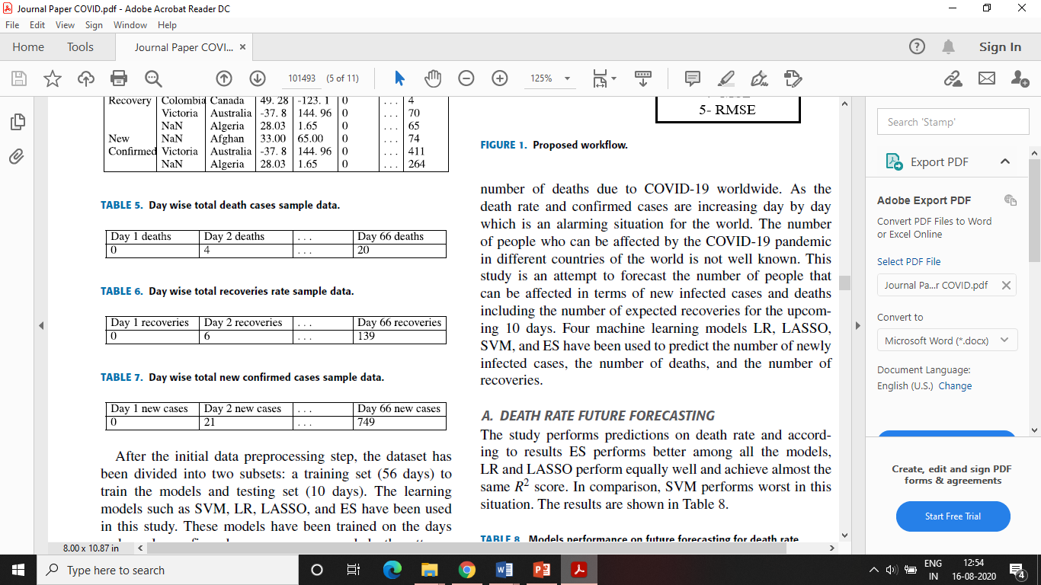
Dataset has been preprocessed for this study to find the global statistics of the daily number of deaths, confirmed cases and recoveries.
Resulted time-series has been extracted from the reported data is shown below:

Slide 17
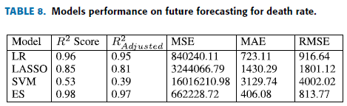
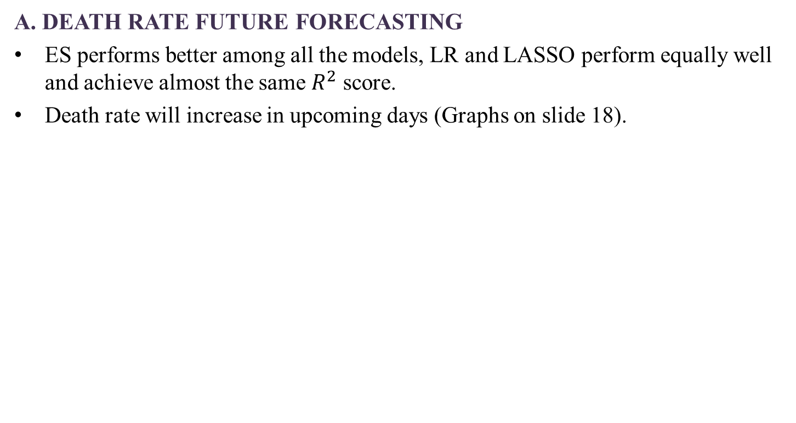
RESULTS AND DISCUSSION
A. DEATH RATE FUTURE FORECASTING
ES performs better among all the models, LR and LASSO perform equally well and achieve almost the same $R^{2}$ score.
Death rate will increase in upcoming days (Graphs on slide 18).

Slide 18
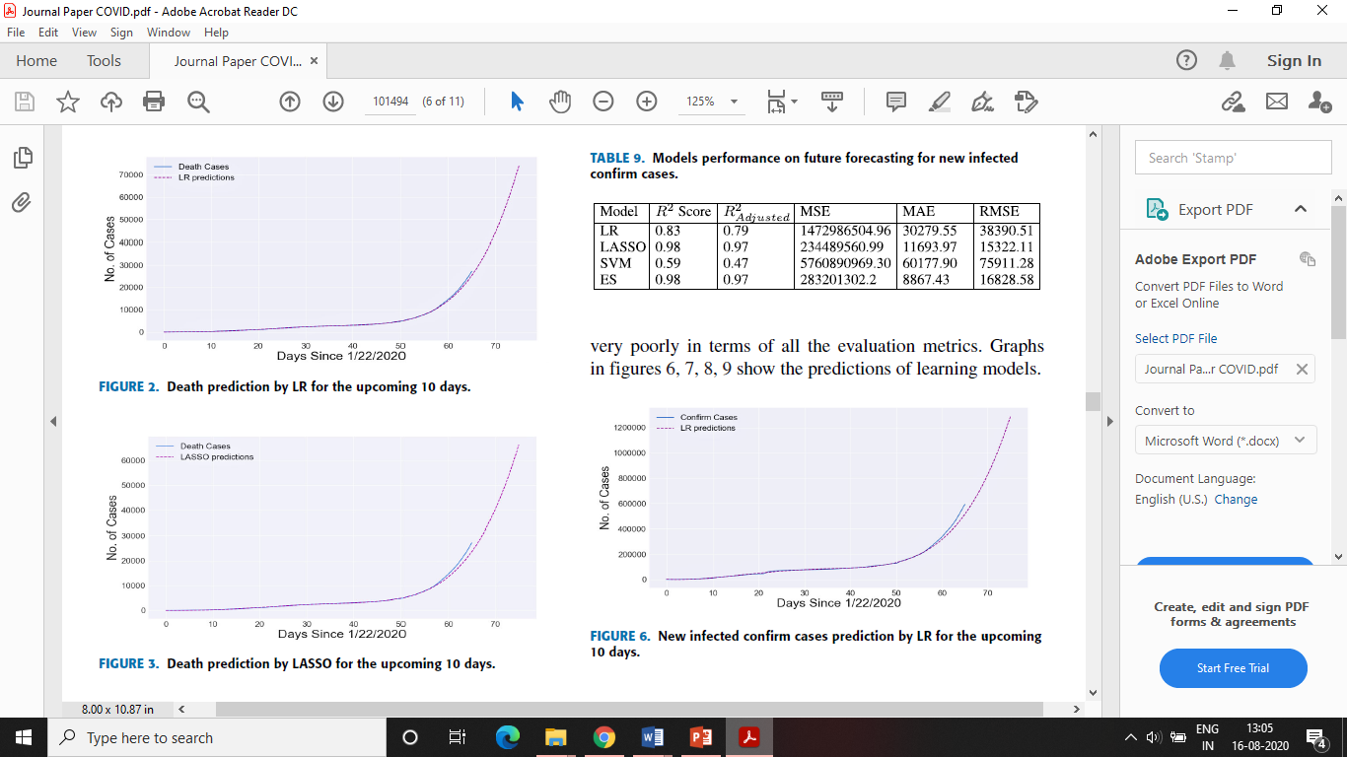
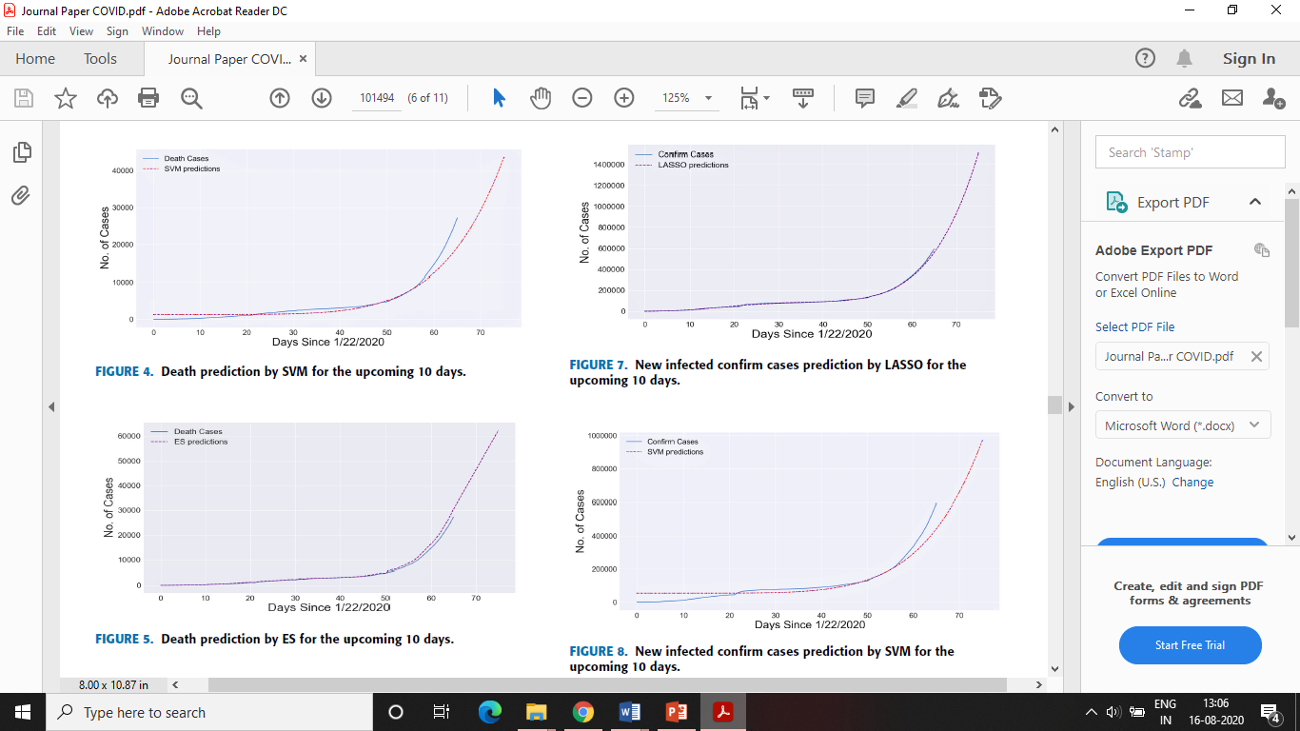

Slide 19

B. NEW INFECTED CONFIRM CASES FUTURE FORECASTING
ES and LASSO lead the table in terms of performance, LR also performed good.

Slide 20
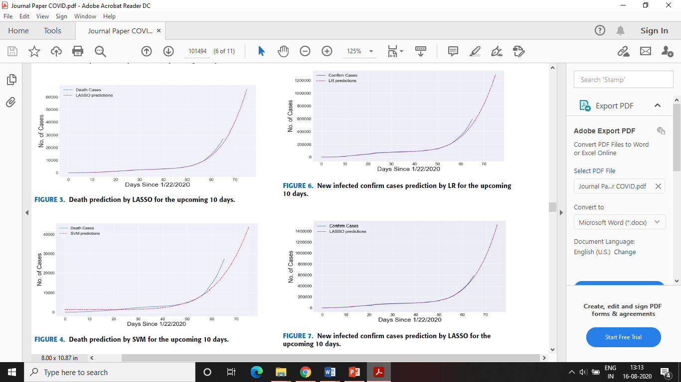
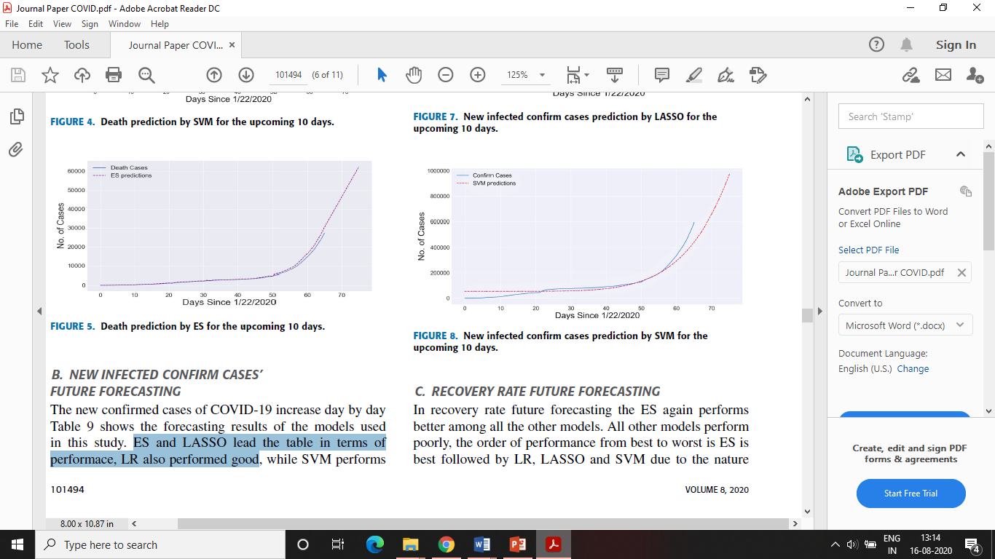
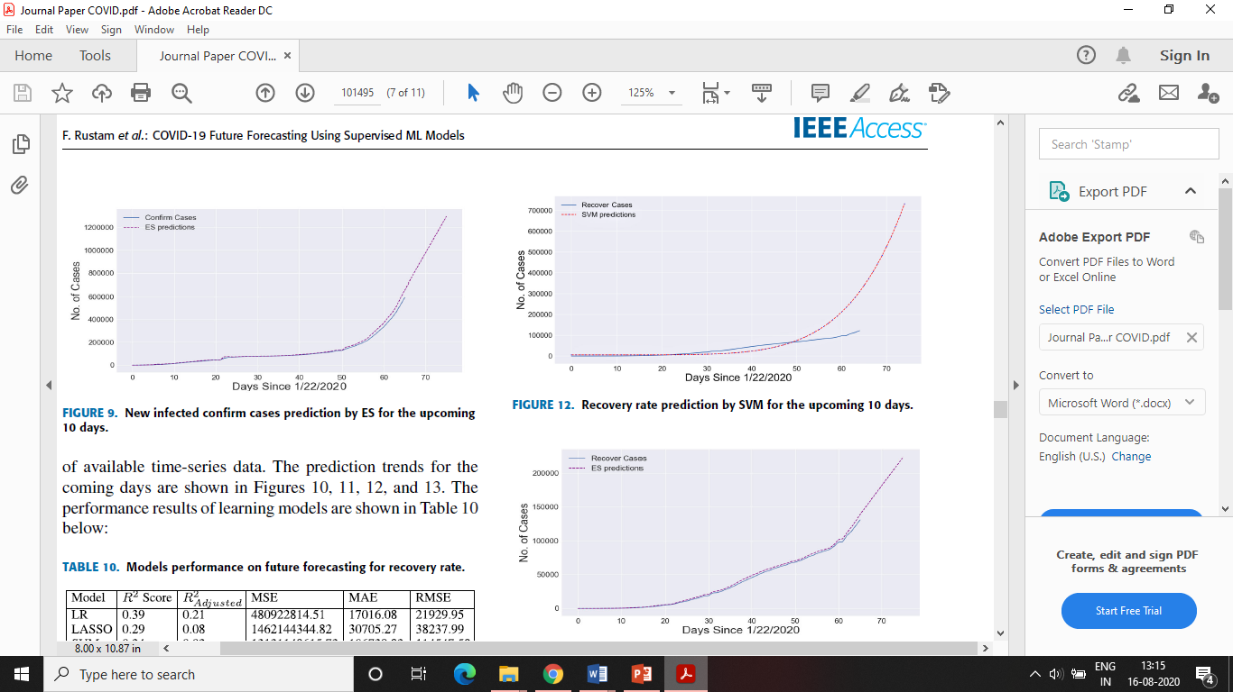

Slide 21
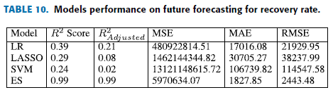
C. RECOVERY RATE FUTURE FORECASTING
ES again performs better among all the other models. All other models perform poorly, the order of performance from best to worst is ES is best followed by LR, LASSO and SVM.
Recoveries will slow down in upcoming days (Graphs on slide 22).

Slide 22
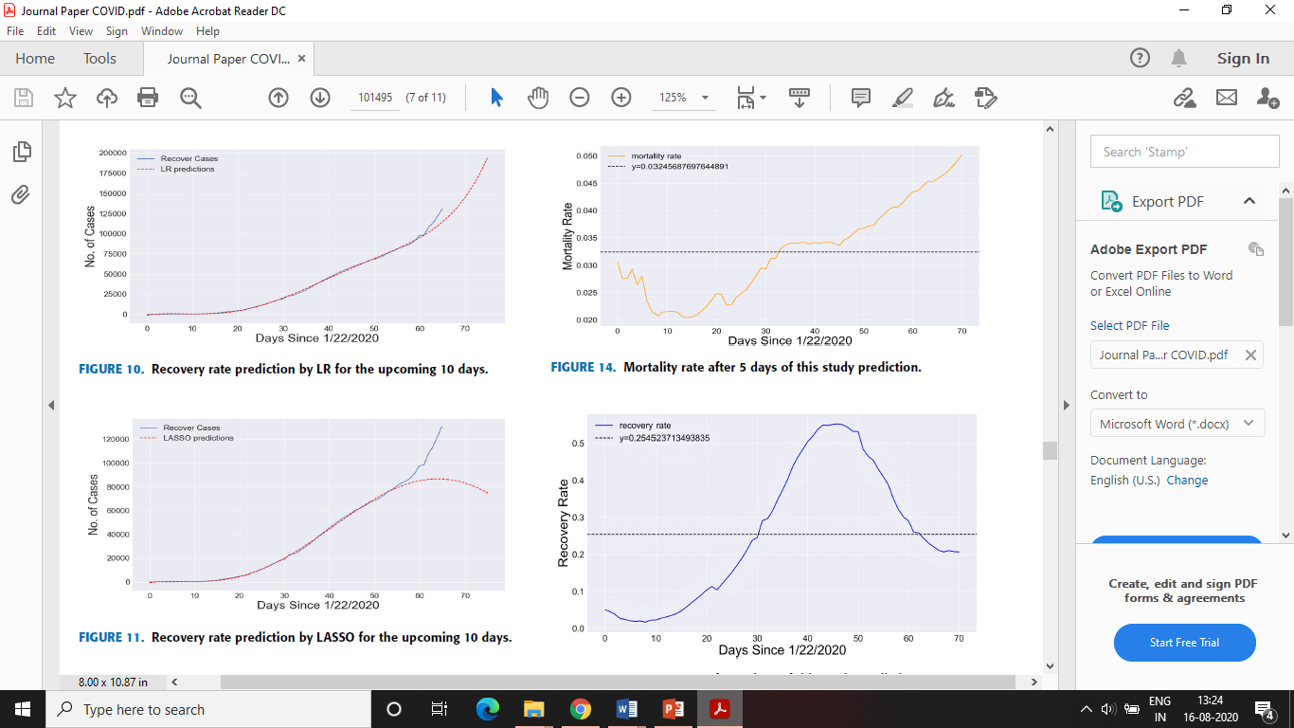
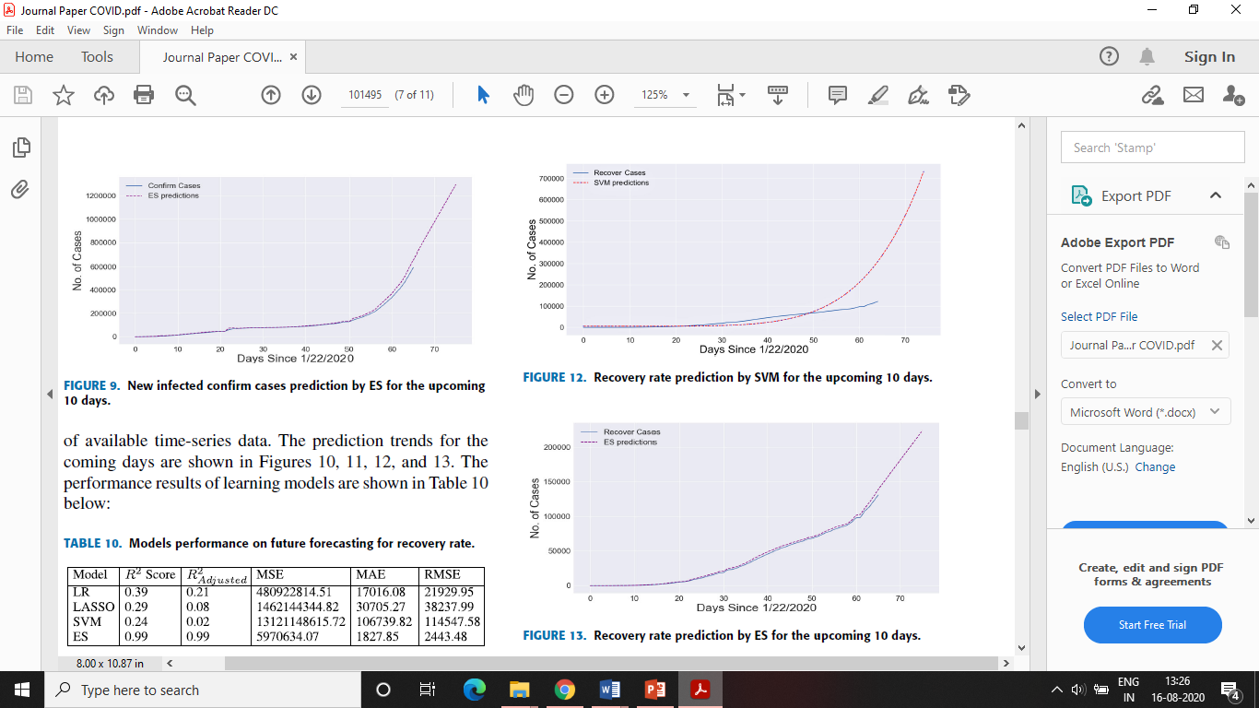

Slide 23
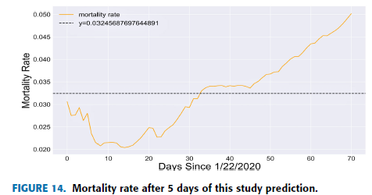
DEATH RATE FUTURE FORECASTING COMPRISON WITH MORTALITY RATE
The current mortality rate plotted in the graph in Figure 14 shows the models predictions correct.

Slide 24
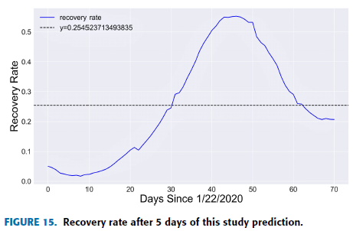
RECOVERY RATE FUTURE FORECASTING COMPRISON WITH RECOVERY RATE
Recovery graph in Figure 15 follows the same pattern which proves the model predictions correct.

Slide 25
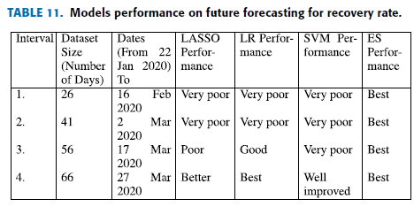
MODELS PERFORMANCE WITH 10-15 DAYS PREDICTION INTERVAL

Slide 26
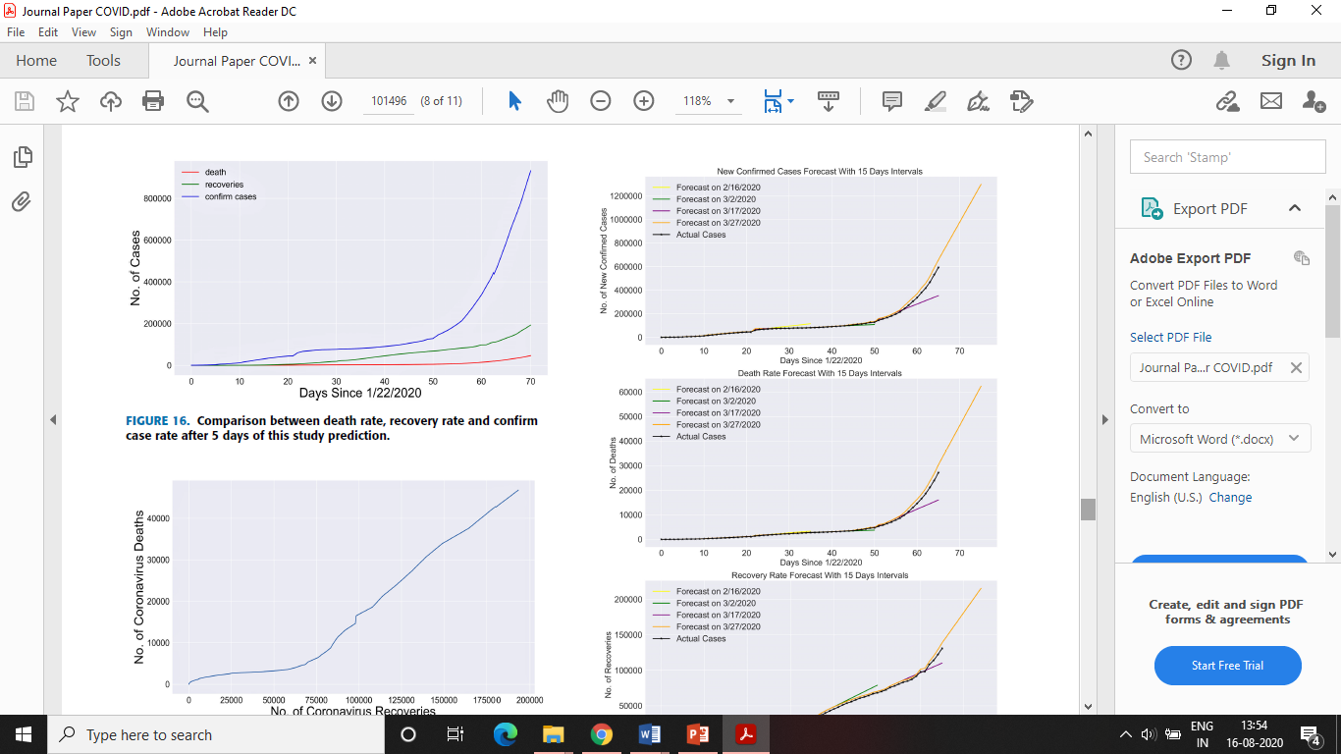
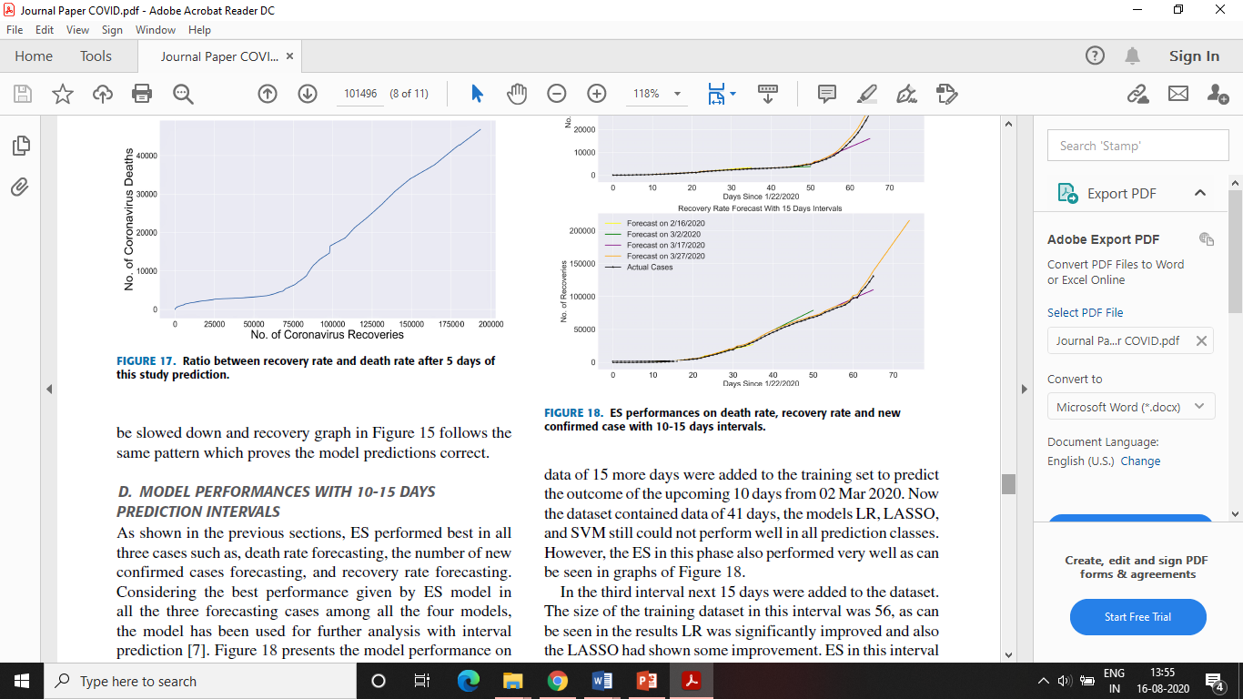

Slide 27
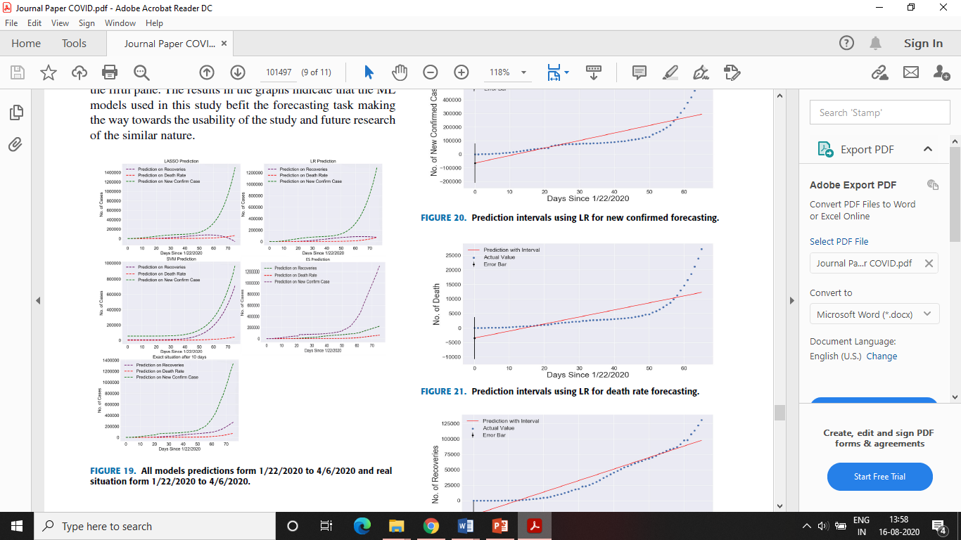
Same methodology has been applied to further forecast the number of confirmed cases, deaths, and recoveries up to 6 Apr 2020. The results in the graphs indicate that the ML models used in this study bet the forecasting task making the way towards the usability of the study and future research of the similar nature.

Slide 28
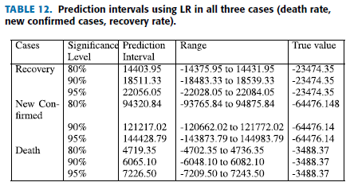
PREDICTION INTERVAL OF LR FOR FORCASTING UNCERTINITY
To evaluate this uncertainty authors performed prediction intervals on LR.

Slide 29
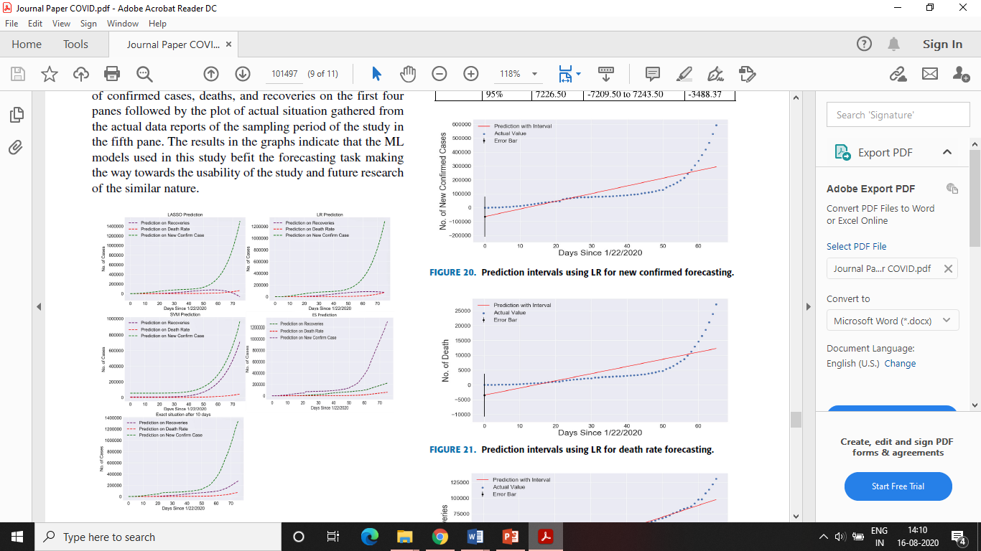
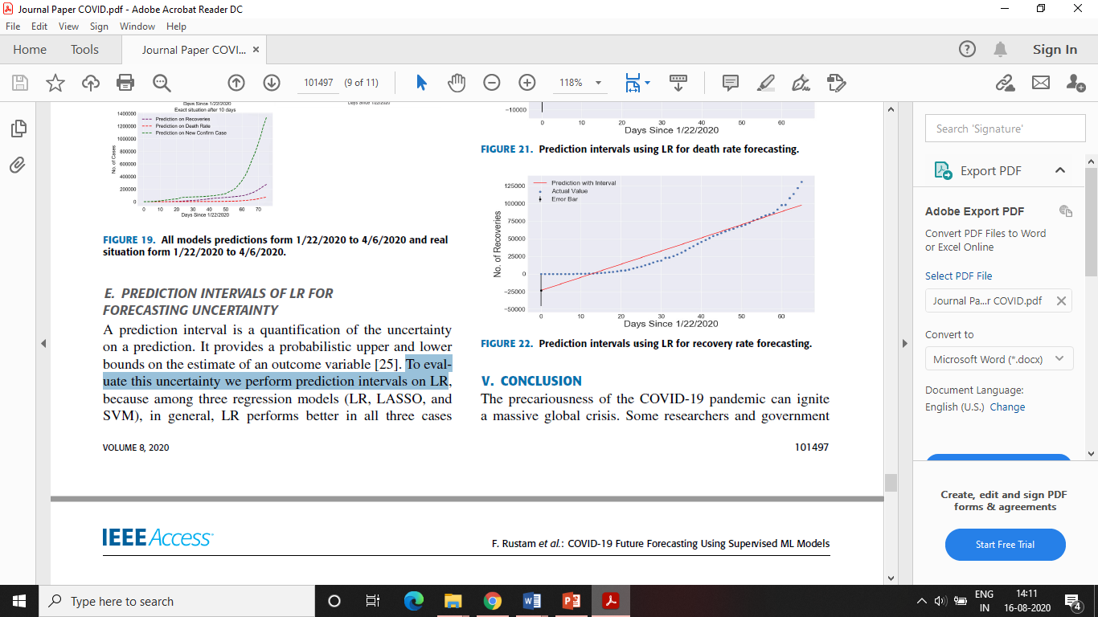

Slide 30
CONCLUSION
A ML based prediction system has been proposed for predicting the risk of COVID-19 outbreak globally.
System analyses dataset containing the day-wise actual past data and makes predictions for upcoming days using machine learning algorithms.
ES performs best in the current forecasting domain given the nature and size of the dataset.
LR and LASSO also perform well for forecasting to some extent to predict death rate and confirm cases.
Overall we conclude that model predictions according to the current scenario are correct which may be helpful to understand the upcoming situation.

Slide 31
`
Critical Care Utilization for the COVID-19 Outbreak in Lombardy, Italy: Early Experience and Forecast During an Emergency Response
G. Grasselli, A. Pesenti and M. Cecconi, “Critical care utilization for the COVID-19 outbreak in Lombardy, Italy: early experience and forecast during an emergency response,” Jama, vol. 323, no. 16, pp.1545-1546, Apr. 2020.

Slide 32
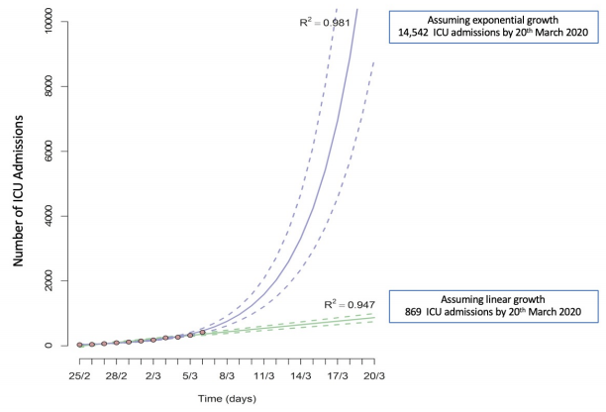
Linear and exponential models were created to estimate further ICU demand.
Fig. 1. Linear and Exponential Models Were Fitted to the Number of Occupied ICU Beds Over Time to Predict the Demand for ICU Beds Up to March 20, 2020

Slide 33
`
Predictive Modeling of Covid-19 Data in the US: Adaptive Phase-Space Approach
V. Marmarelis, “Predictive modeling of Covid-19 data in the US: adaptive phase-space approach,” IEEE Open Journal of Engineering in Medicine and Biology, June 2020.

Slide 34
Model should be interpretable in terms of the dynamic characteristics of the epidemic process (e.g. infectivity rate etc.) in order to assist policy planning and operational implementation.

Slide 35
`
On the Analysis of COVID19–Novel Corona Viral Disease Pandemic Spread Data Using Machine Learning Techniques
S. S. Arun and G. Neelakanta Iyer, “On the analysis of COVID19 - novel corona viral disease pandemic spread data using machine learning techniques,” in Proc. of 4th International Conference on Intelligent Computing and Control Systems (ICICCS), Madurai, India, pp.1222-1227, June 2020.

Slide 36
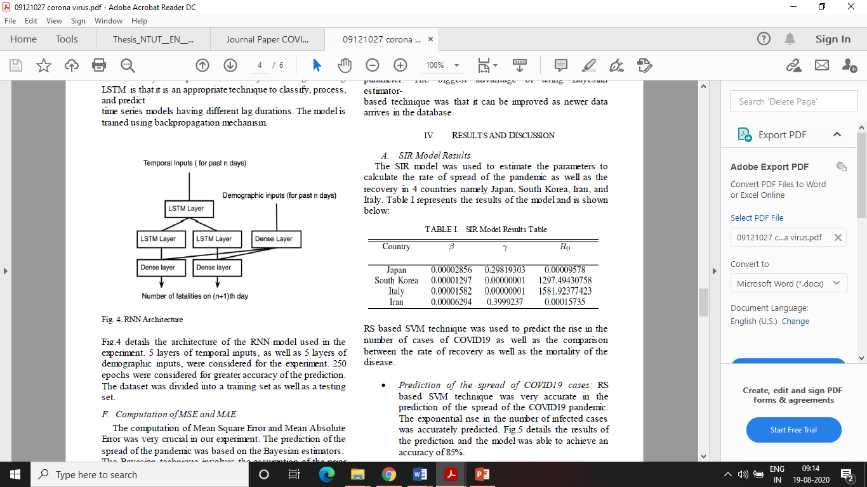
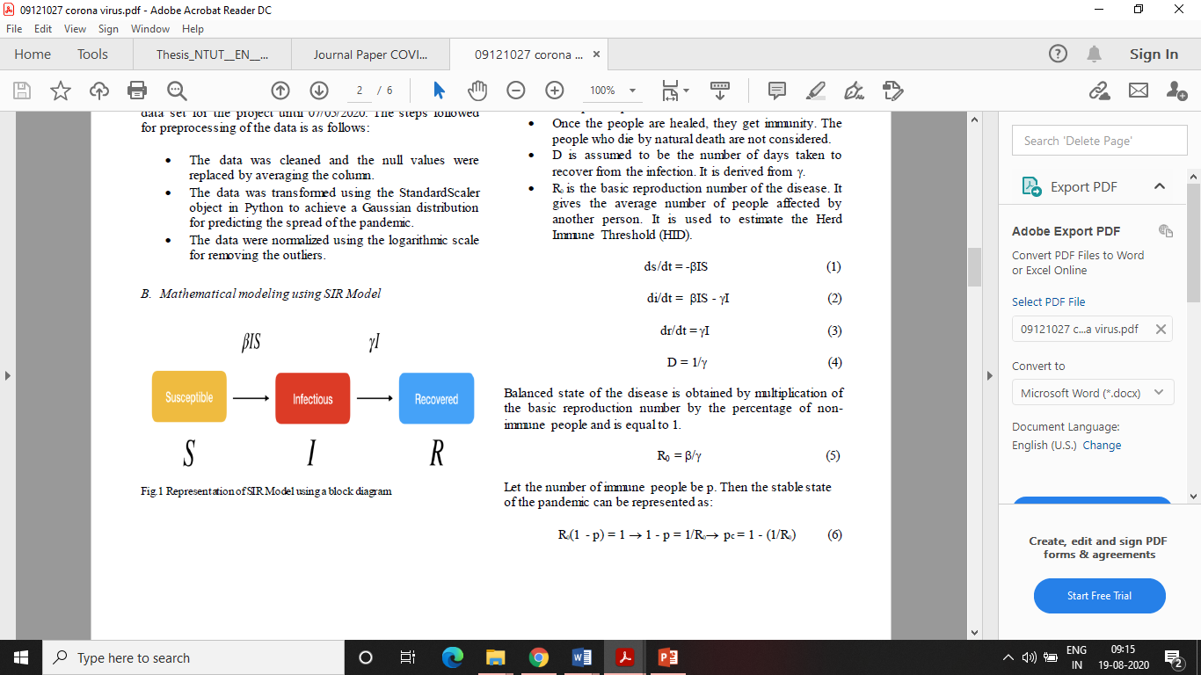
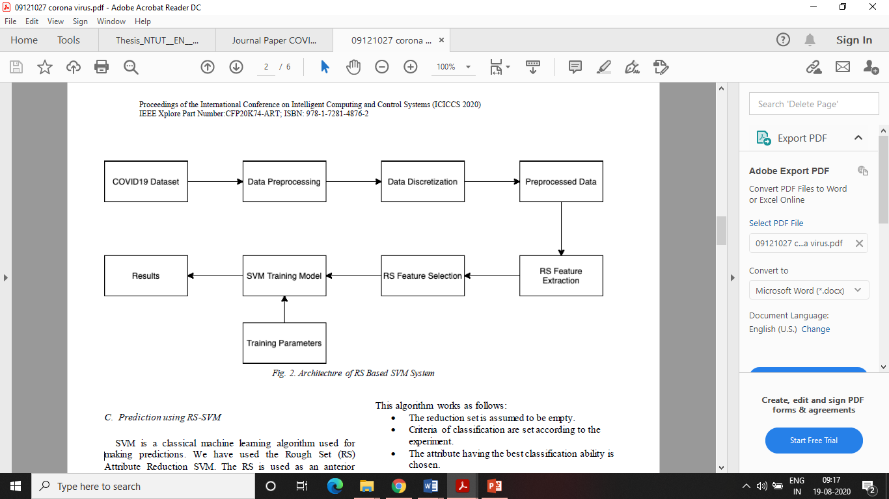

Slide 37
Thank You

